Slide 1
Human-level Concept Learning through
Probabilistic Program Induction
Brenden Lake
Ruslan Salakhutdinov
Joshua B. Tenenbaum
Institute of Computing Technology, Chinese Academy of Sciences
2020.11.19

Slide 2
CONTENTS
Motivation
One-shot Classification
Visual Turing Test
Bayesian Program Learning
Few-shot Learning

Slide 3
Motivation

Slide 4
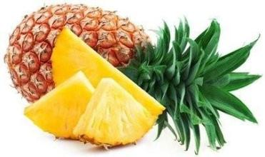

One-shot Learning
Pretend you’ve never seen a pineapple. After seeing just one, it would be very easy for you
To identify a pineapple in a bowl of other fruits.
To tell the difference between its leaves and its body.
To draw something that kind of looks like a pineapple.
To sketch something inspired by a pineapple but slightly different.

Slide 5
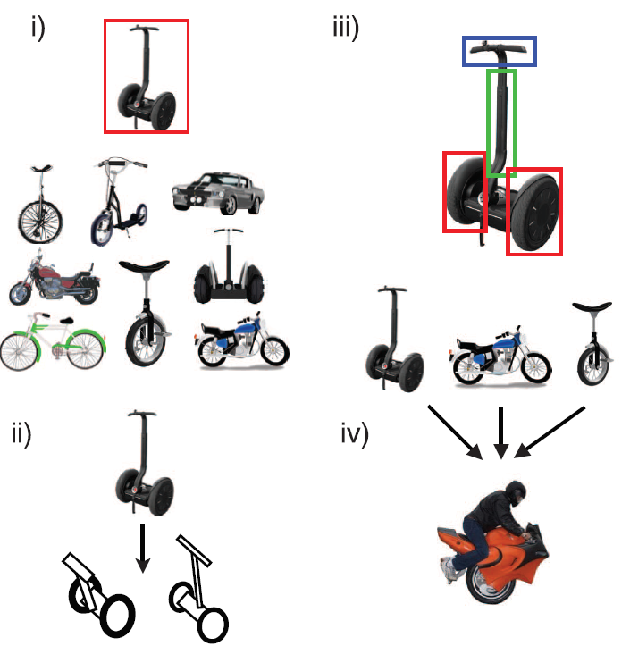
Motivation
Human
Few examples
Rich representation
Machine
Massive labeled samples
Single representation
Notes:
classification of new examples,
generation of new examples,
parsing an object into parts and relations (parts segmented by color)
generation of new concepts from related concepts.
With this prior knowledge, computer programs can also learn to classify, parse and generate new handwritten characters with a few examples like humans.

Slide 6
One-shot Classification

Slide 7

50 different alphabets
1623 handwritten characters
Drawn by 20 different people
Stroke data: [x,y,t] coordinates

Slide 8
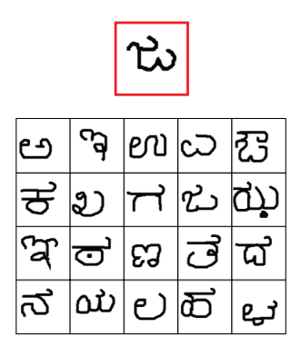
Omniglot:
Background set: 30 alphabet
Evaluation set: 20 alphabet
Within-alphabets classification:
10 different alphabets from evaluation set
Training: 20 different characters
Testing: a new character

Slide 9
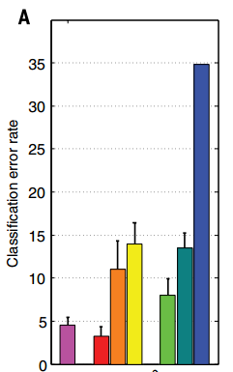
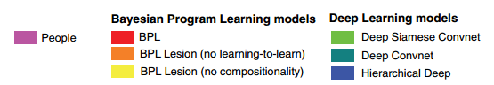
Experiment Results(error rate)
People
4.5%
BPL
3.3%
Deep
8.0%~34.8%

Slide 10
Visual Turing Test

Slide 11
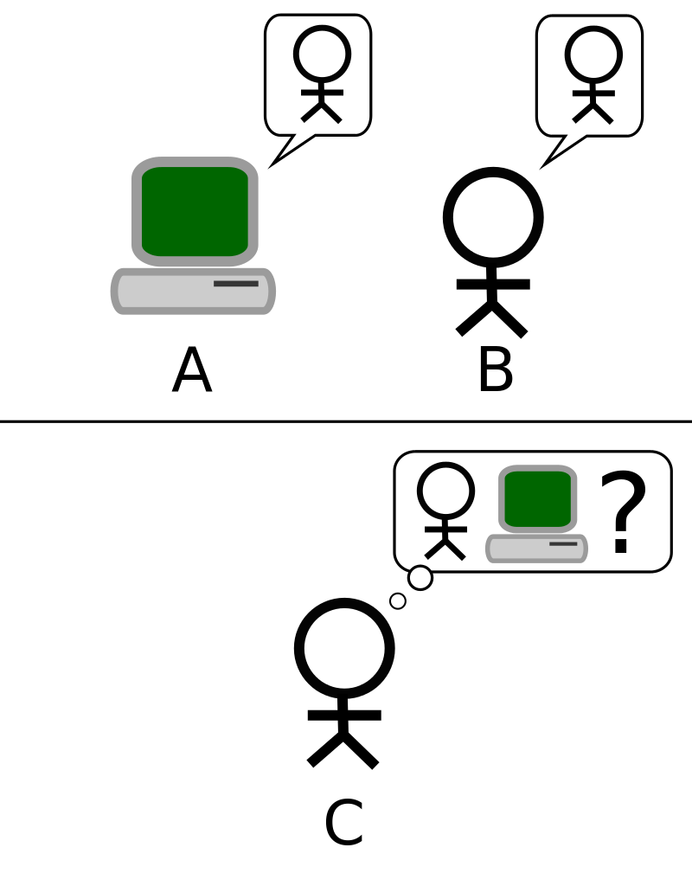
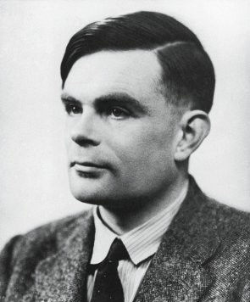
Turing Test
1950
Alan Mathison Turing (1912~1954)
The Turing test can show that a machine could think.
Notes:
A remote human interrogator, within a fixed time frame, must distinguish between a computer and a human subject based on their replies to various questions posed by the interrogator.
英国数学家、逻辑学家，被称为计算机科学之父，人工智能之父。
提出著名的“图灵测试”，指出如果第三者无法辨别人类与人工智能机器反应的差别， 则可以论断该机器具备人工智能。
2011年
犹大·伯尔
Judea Pearl
人工智能
1969年
马文·明斯基
Marvin Minsky
人工智能
1971年
约翰·麦卡锡
John McCarthy
人工智能

Slide 12
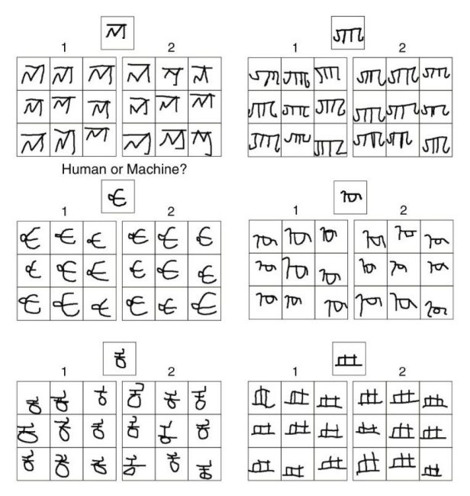
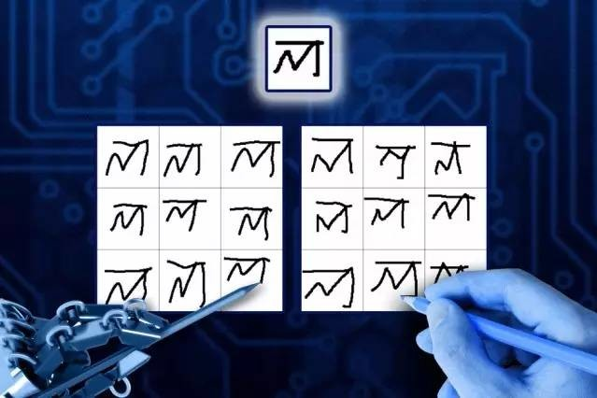
Which is written by human?
New exemplars

Slide 13
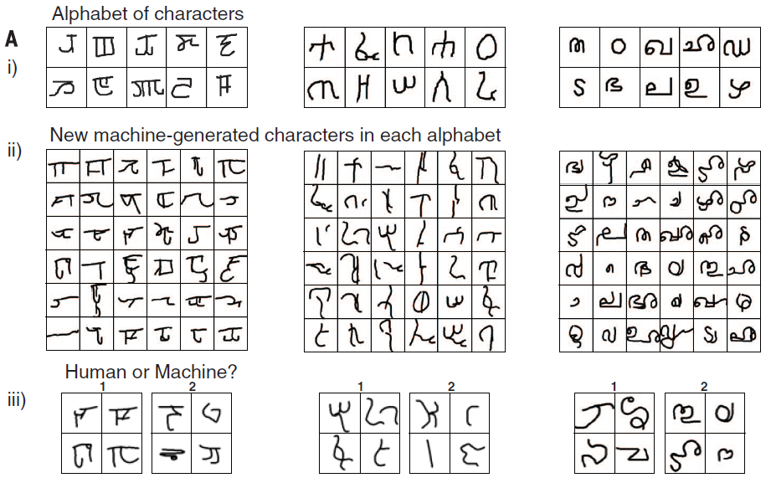
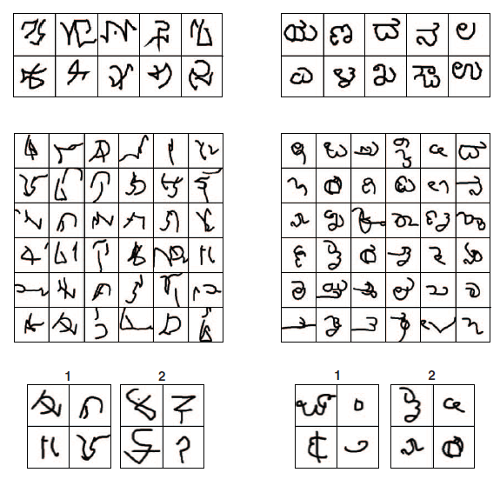
Which is written by human?
New concepts from type

Slide 14
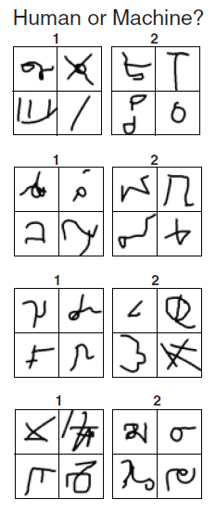
Which is written by human?
New concepts unconstrained

Slide 15

Visual Turing Test

Slide 16
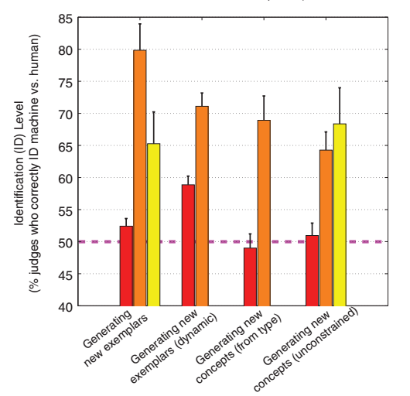
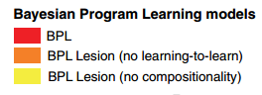
Identification Level
147 Judges
49 Trials
Best ID Level: 50%
Worst ID Level: 100%

Slide 17
CONTENTS
Motivation
One-shot Classification
Visual Turing Test
Bayesian Program Learning
Few-shot Learning

Slide 18
Bayesian Program Learning

Slide 19
Key Ideas
Compositionality
Causality
Learning to learn
Notes:
As programs, rich concepts can be built “compositionally” from simpler primitives.
the abstract “causal” structure of the real-world processes that produce examples of a category
the model “learns to learn” (23, 24) by developing hierarchical priors that allow previous experience with related concepts to ease
learning of new concepts

Slide 20
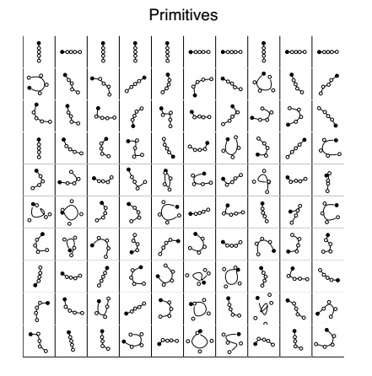
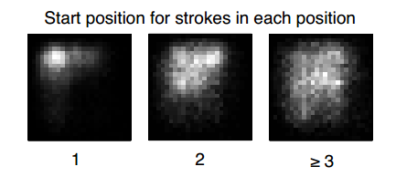

Slide 21
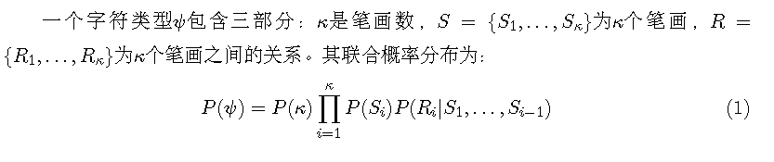
类别层符号

Slide 22
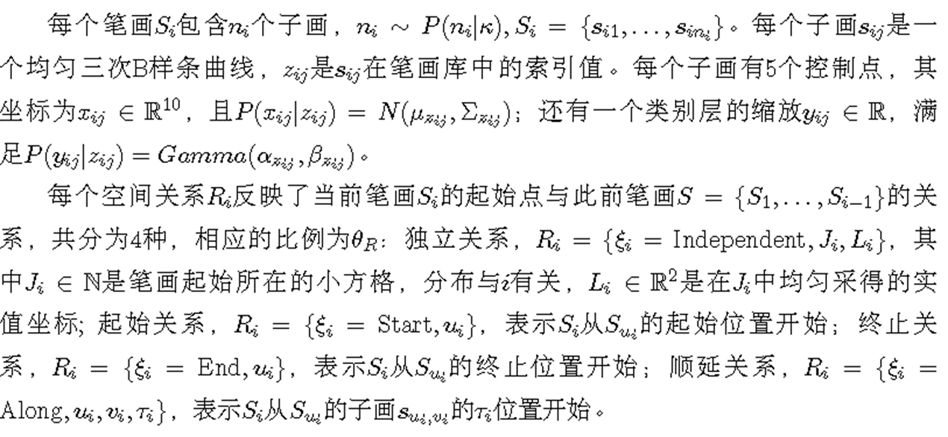
类别层符号

Slide 23
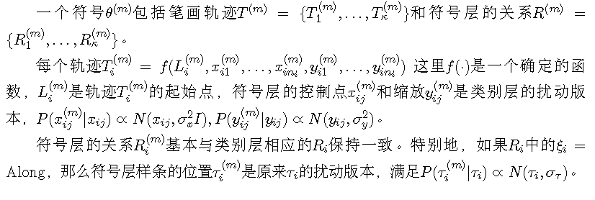
符号层

Slide 24
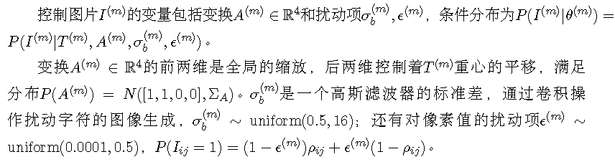
图片层

Slide 25
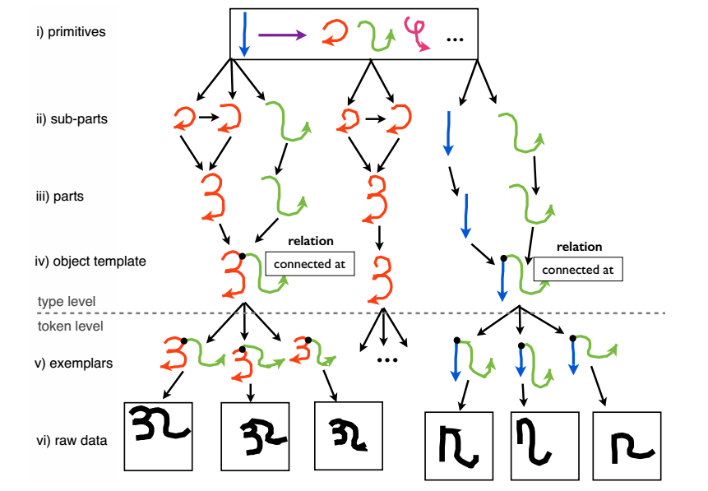
Basic Concepts

Slide 26
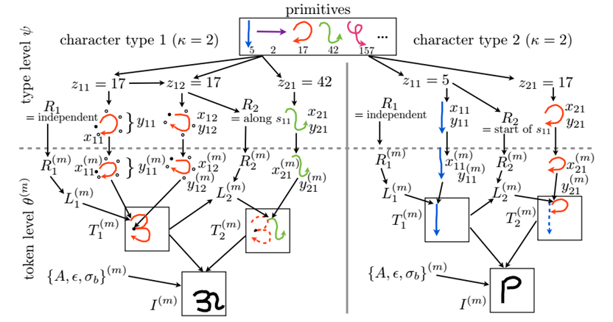

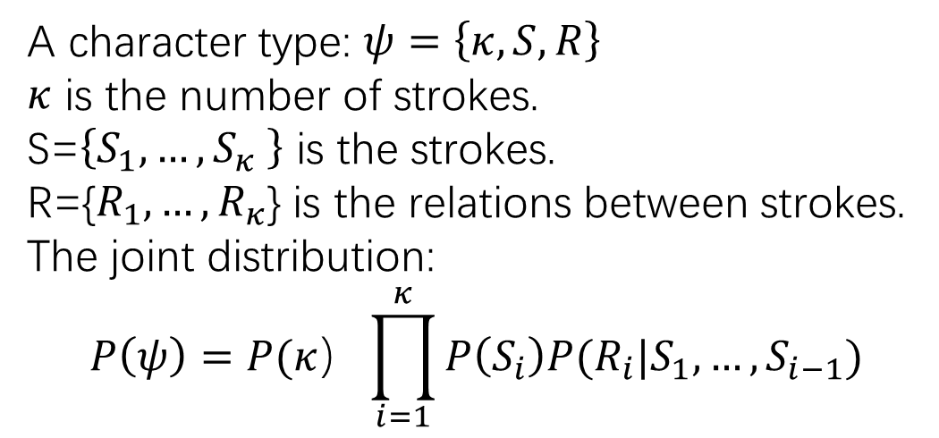
Type-level
A character type: $ψ=\left\{κ,S,R\right\}$
$κ$ is the number of strokes.
S=$\left\{S_{1},…,S_{κ} \right\}$ is the strokes.
R={$R_{1},…,R_{κ}$} is the relations between strokes.
The joint distribution:
$$P\left(ψ\right)=P(κ）\prod_{i=1}^{κ}{P\left(S_{i}\right)P(R_{i}|S_{1},…,S_{i−1})}$$

Slide 27
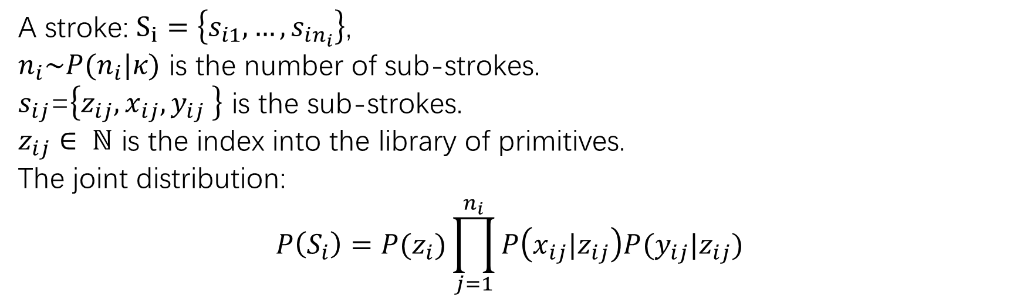
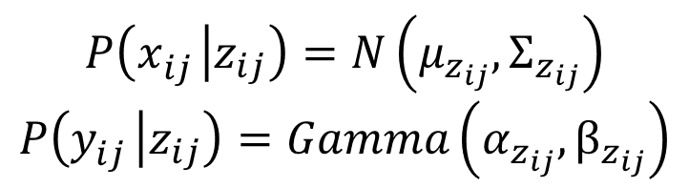
Type-level
A stroke: $S_{i}=\left\{s_{i1},…,s_{in_{i}}\right\}$,
$n_{i}\sim P(n_{i}|κ)$ is the number of sub-strokes.
$s_{ij}$=$\left\{z_{ij},x_{ij},y_{ij} \right\}$ is the sub-strokes.
$z_{ij}∈ ℕ$ is the index into the library of primitives.
The joint distribution:
$$P\left(S_{i}\right)=P(z_{i})\prod_{j=1}^{n_{i}}{P\left(x_{ij}|z_{ij}\right)P(y_{ij}|z_{ij})}$$
$$P\left(x_{ij}^{} | z_{ij}\right)=N\left(μ_{z_{ij}}, Σ_{z_{ij}}\right)$$
$$P\left(y_{ij}^{} | z_{ij}\right)=Gamma\left(α_{z_{ij}}, β_{z_{ij}}\right)$$

Slide 28
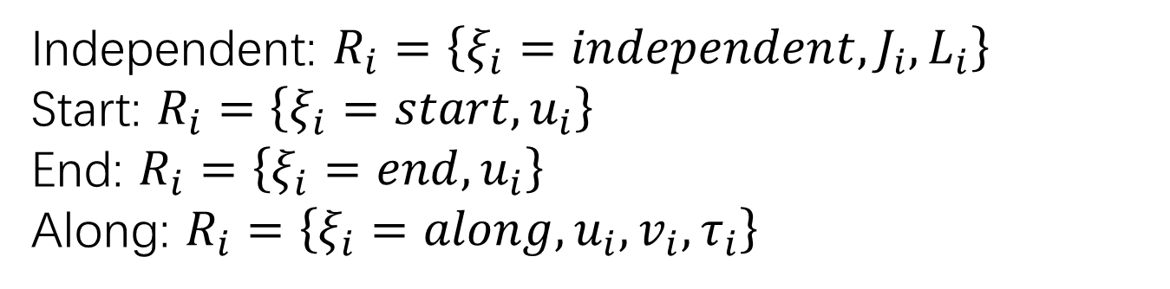
Type-level
Relationships
Independent: $R_{i}=\left\{ξ_{i}=independent,J_{i},L_{i}\right\}$
Start: $R_{i}=\left\{ξ_{i}=start,u_{i}\right\}$
End: $R_{i}=\left\{ξ_{i}=end,u_{i}\right\}$
Along: $R_{i}=\left\{ξ_{i}=along,u_{i},v_{i},τ_{i}\right\}$

Slide 29
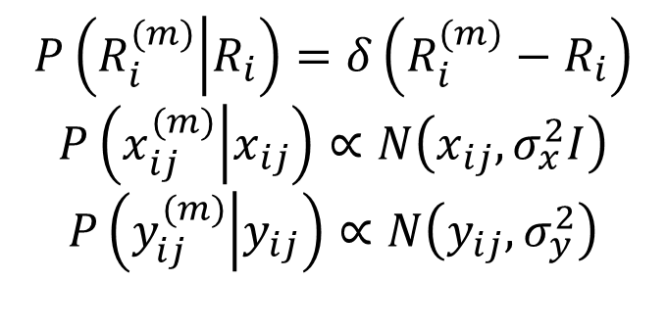
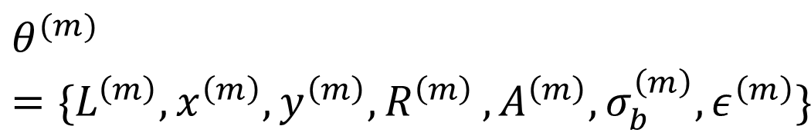
Token-level
$$θ^{(m)}=\{L^{\left(m\right)},x^{\left(m\right)},y^{\left(m\right)}{,R}^{\left(m\right)},A^{\left(m\right)},σ_{b}^{\left(m\right)},ε^{\left(m\right)}\}$$
$$P\left(R_{i}^{(m)} | R_{i}\right)=δ\left(R_{i}^{(m)}−R_{i}\right)$$
$$P\left(x_{ij}^{(m)} | x_{ij}\right)∝N\left(x_{ij},σ_{x}^{2}I\right)$$
$$P\left(y_{ij}^{(m)} | y_{ij}\right)∝N\left(y_{ij},σ_{y}^{2}\right)$$

Slide 30

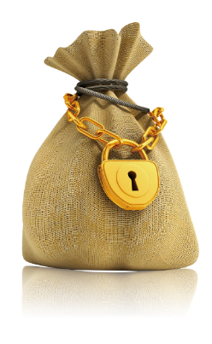
Learning-to-learn motor programs
Learning primitives
Learning start positions
Learning relations and token variability
Learning image parameters

Slide 31
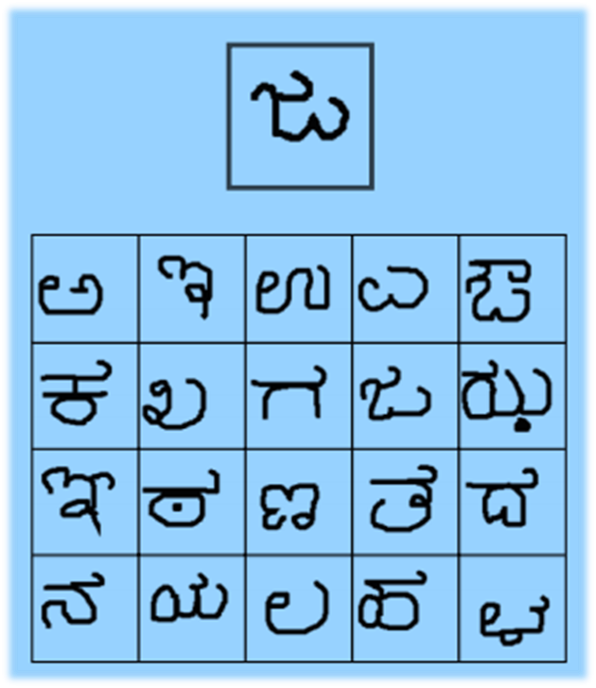
Inference for
One-shot Classification

Slide 32
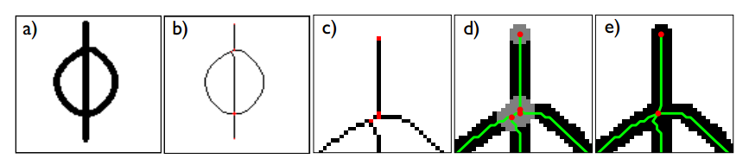
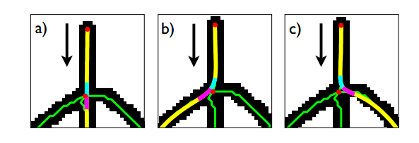
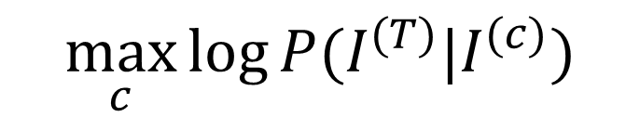
Inference for one-shot classification
Extract skeleton
单击编辑标题
Random walk
Posterior score
$$\max_{c}{\log{P(I^{(T)}|I^{(c)})}}$$

Slide 33

Extracting the character skeleton
Reduce the line width to one pixel
Detect the decision point
Merge the spurious points

Slide 34
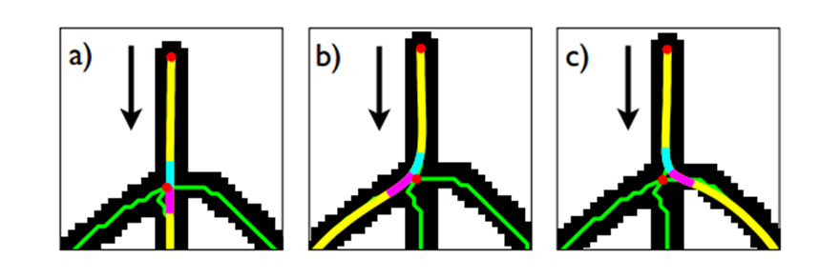
Generating random parses
Take random walk on the skeleton
Minimize the local angle
Stop until 150 parses or 100 unique strokes

Slide 35
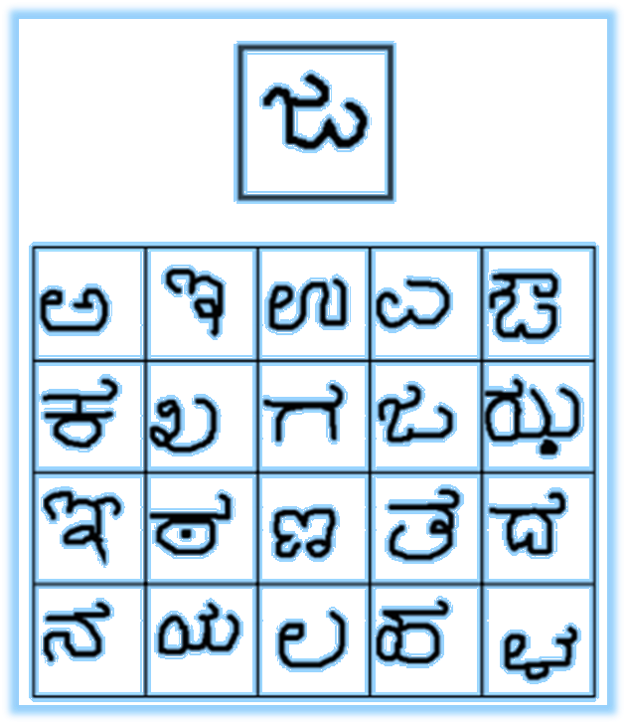
Inference for one-shot classification
Training images: $I^{(c)}, c=1,…,C$
Testing images: $I^{(T)}$
Take parses of $I^{(c)}$ refit to $I^{(T)}$
$$\max_{c}{\log{P(I^{(T)}|I^{(c)})}}$$

Slide 36
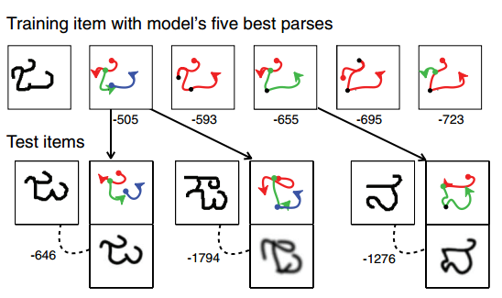

Slide 37
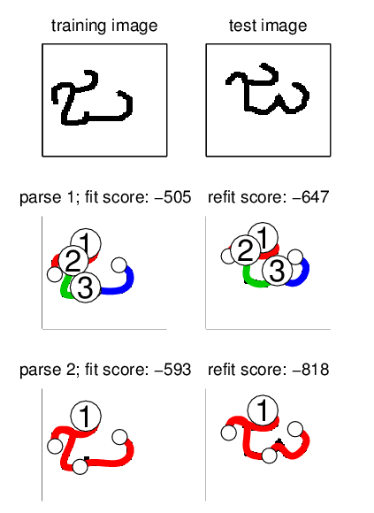
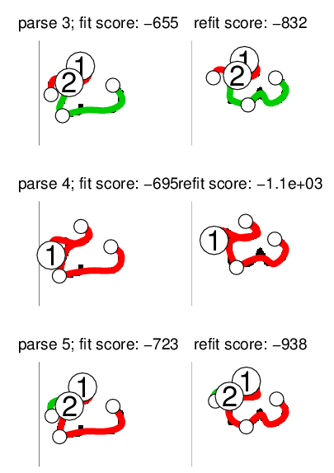

Slide 38
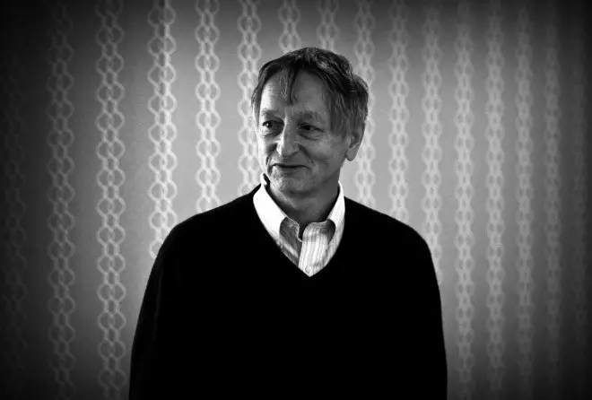
Quotations from Hinton
The model’s ability to pass a visual Turing test is significant.
The two approaches (Bayesian Program Learning and deep learning) succeed at different types of tasks, and both can improve by borrowing from one another — and that even greater successes could come from creating hybrid systems.

Slide 39
Few-shot Learning

Slide 40
Motivation
Acting as a test bed for learning like human
Few examples
Rich representation
Learning for rare cases
hard or impossible to obtain sufficient examples
Reducing data gathering effort and computational cost

Slide 41
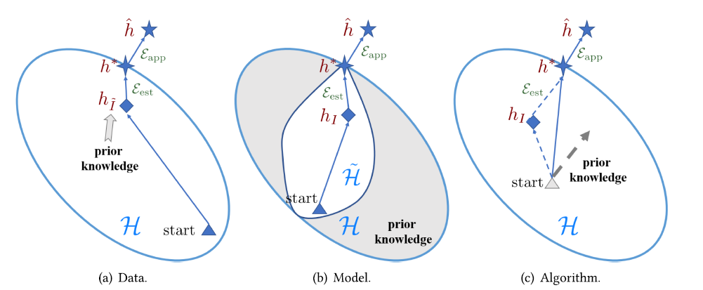
Methodology

Slide 42
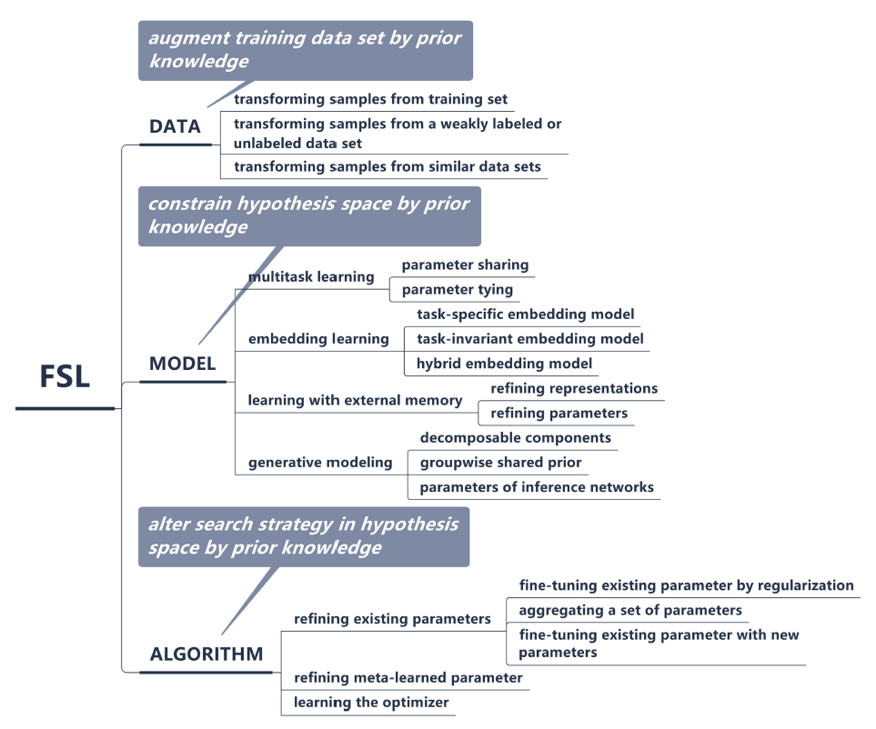
Methodology

Slide 43
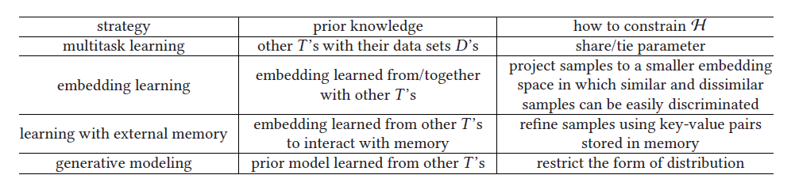
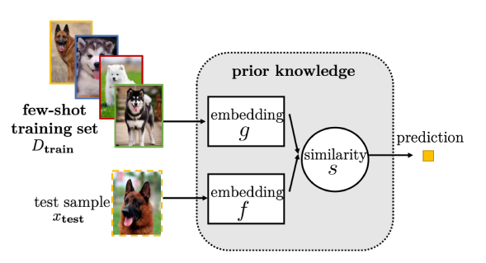
Model
Notes:
Solving the FSL problem by task-invariant embedding model

Slide 44
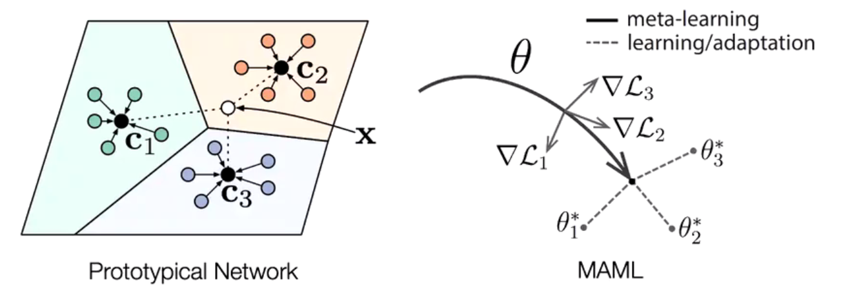
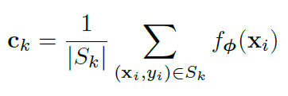
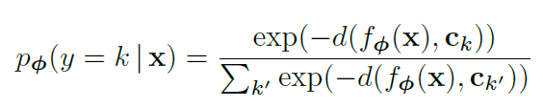
Model
Snell, Jake, Kevin Swersky, and Richard Zemel. "Prototypical networks for few-shot learning." NeurIPS 2017
Notes:
Solving the FSL problem by task-invariant embedding model

Slide 45
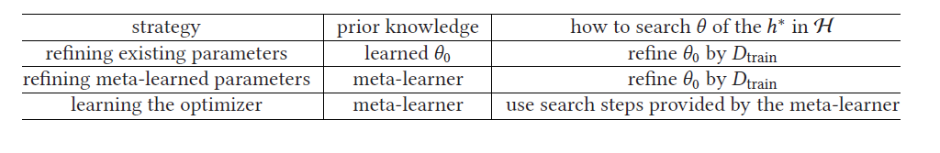
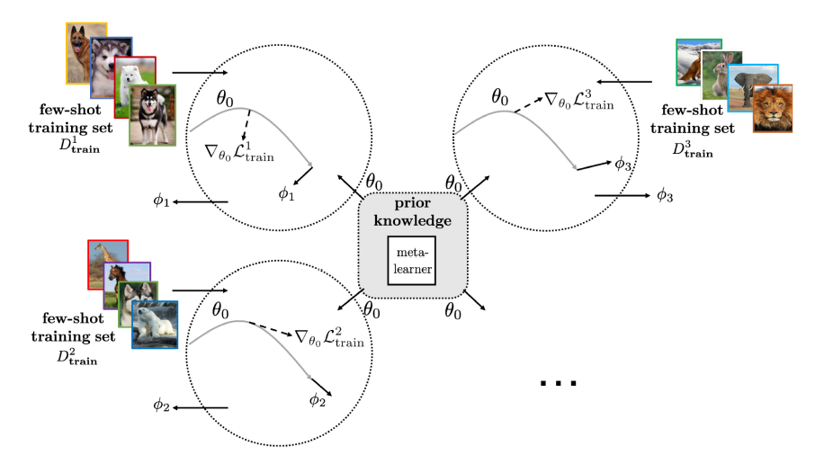
Algorithm

Slide 46
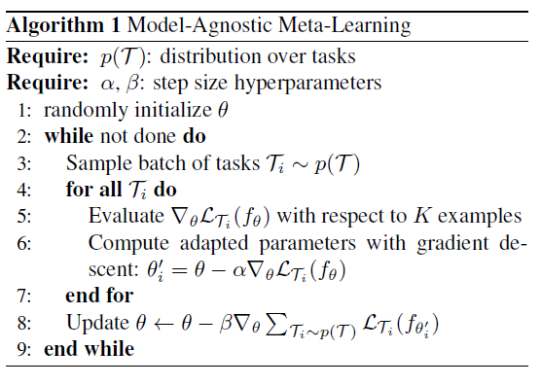
Algorithm
Finn, Chelsea, Pieter Abbeel, and Sergey Levine. "Model-agnostic meta-learning for fast adaptation of deep networks." ICML 2017.

Slide 47
References
Lake, Brenden M., Ruslan Salakhutdinov, and Joshua B. Tenenbaum. "Human-level concept learning through probabilistic program induction." Science 350.6266 (2015): 1332-1338.
Snell, Jake, Kevin Swersky, and Richard Zemel. "Prototypical networks for few-shot learning." NeurIPS 2017
Finn, Chelsea, Pieter Abbeel, and Sergey Levine. "Model-agnostic meta-learning for fast adaptation of deep networks." ICML 2017.
Wang, Yaqing, et al. "Generalizing from a few examples: A survey on few-shot learning." ACM Computing Surveys (CSUR) 53.3 (2020): 1-34.
Triantafillou, Eleni, et al. "Meta-dataset: A dataset of datasets for learning to learn from few examples." ICLR 2020.
Notes:
https://medium.com/@antoine.louis/human-level-concept-learning-through-probabilistic-program-induction-9cc4fd7028c9
https://omgteam.github.io/2017/04/19/BPL/

Slide 48
THANK YOU
Institute of Computing Technology, Chinese Academy of Sciences

